Slide 1
GUIDE to Clinical Cases

Slide 2
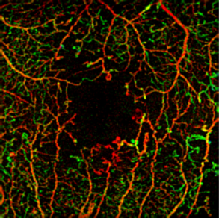
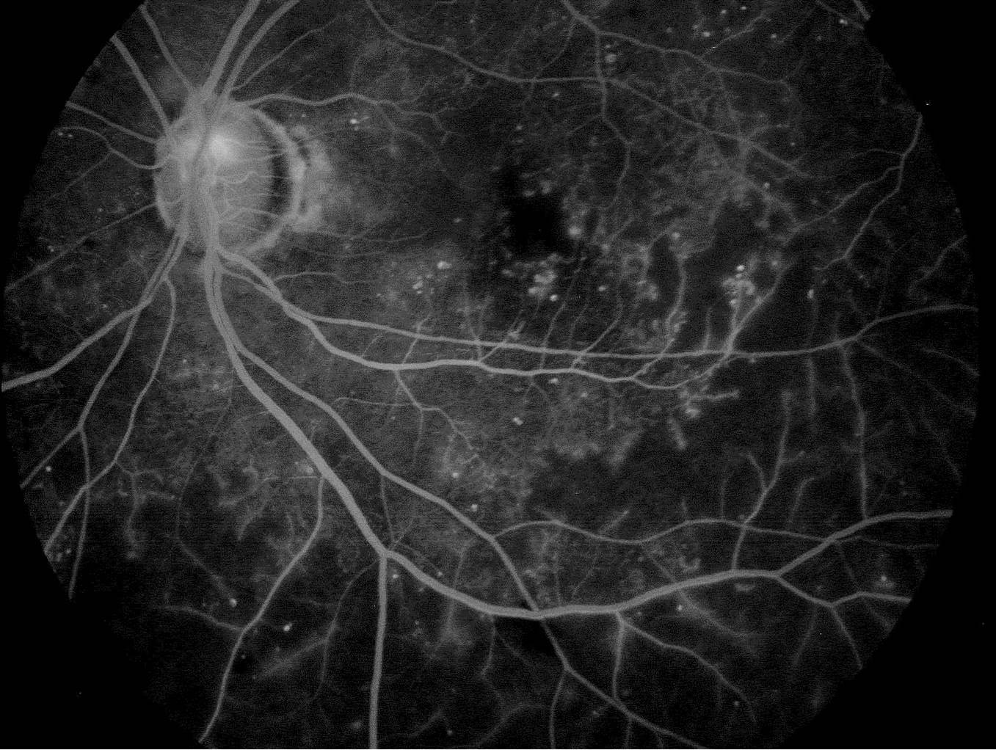
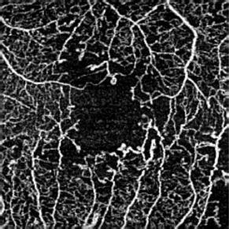
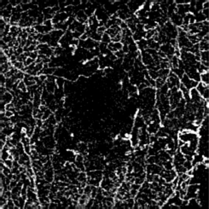
Diabetic Retinopathy
Courtesy of Dr. Scott Lee, East Bay Retina, Oakland, CA
Color depth encoded AngioPlex image
Superficial Retinal Layer AngioPlex image
Color depth encoded AngioPlex image
Overlaid onto traditional FA
Deep Retinal Layer AngioPlex image

Slide 3
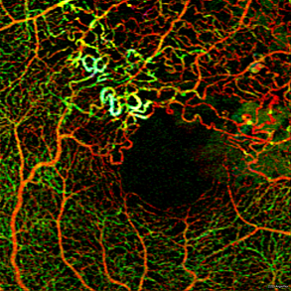
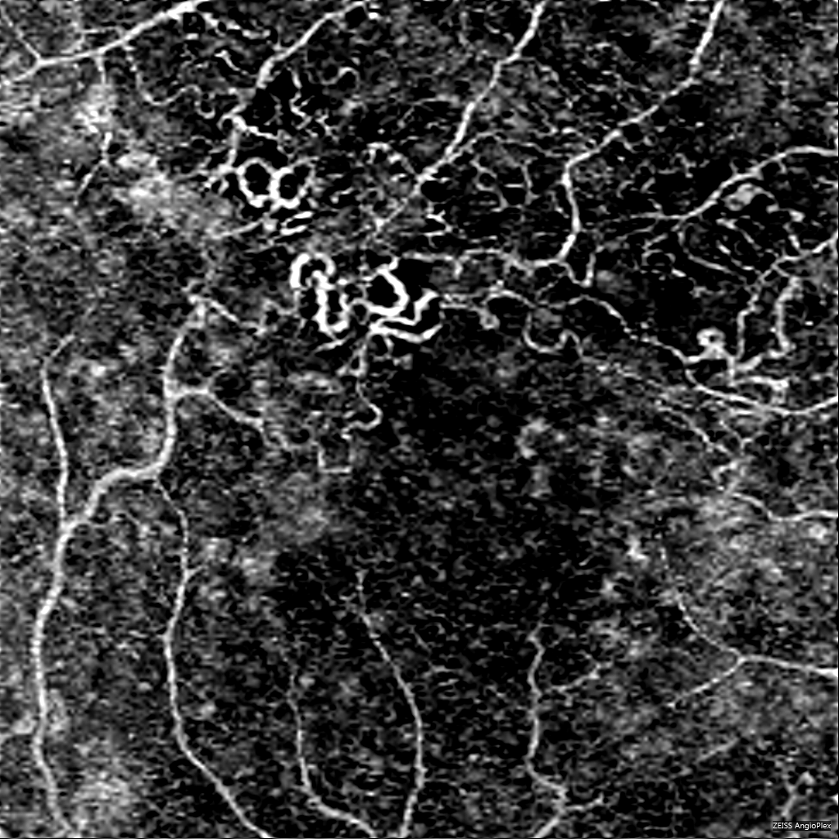
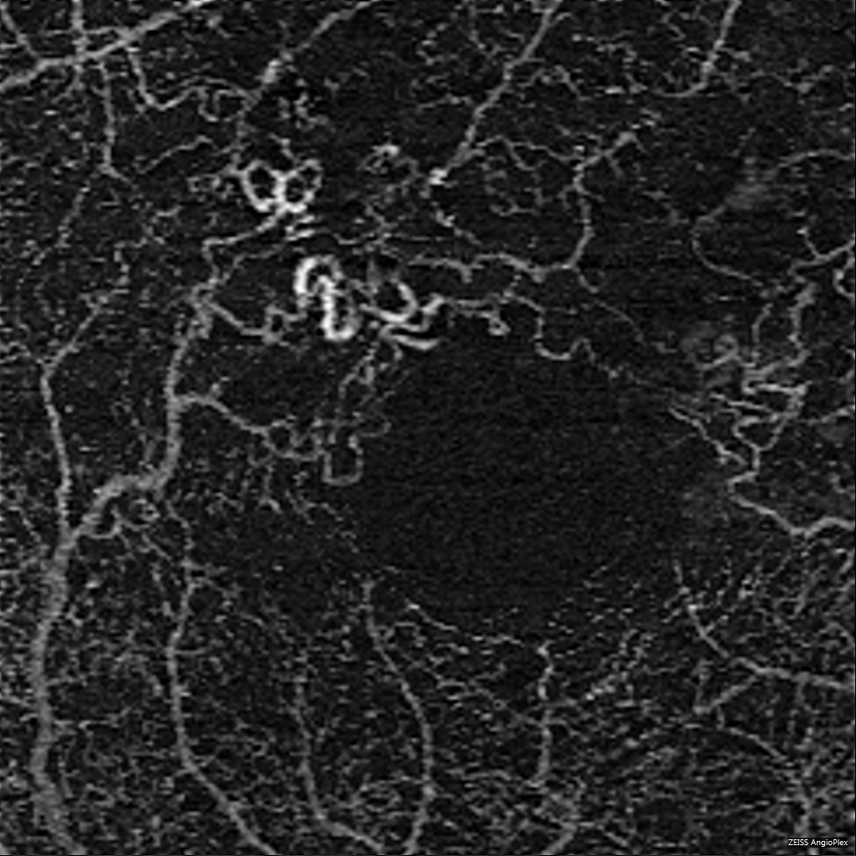
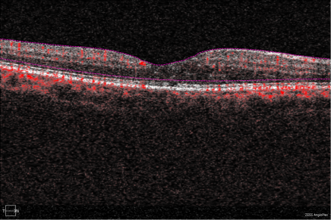
BRVO
Courtesy of Dr. Scott Lee, East Bay Retina, Oakland, CA
Color depth encoded AngioPlex image
Superficial Retinal Layer AngioPlex image
Deep Retinal Layer AngioPlex image
B-scan showing blood flow
Color depth encoded AngioPlex image
Overlaid onto traditional FA

Slide 4
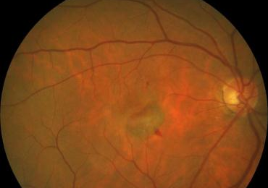
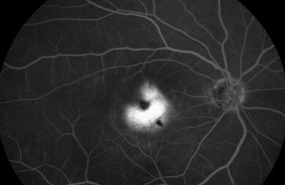
AMD
Courtesy of J.F. Korobelnik. Department of Ophthalmology, Centre Hospitalier Universitaire de Bordeaux, Hospital Pellegrin, Bordeaux, France
Notes:
CAS 1: 109 Type 1 CNV in wet AMD

Slide 5
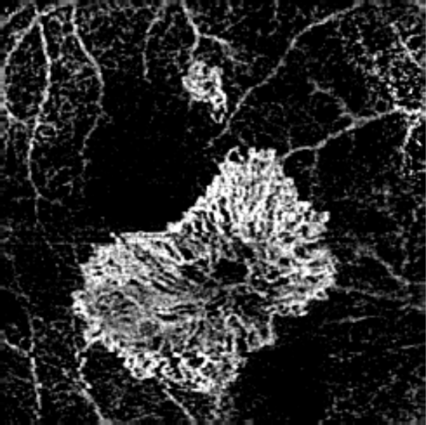
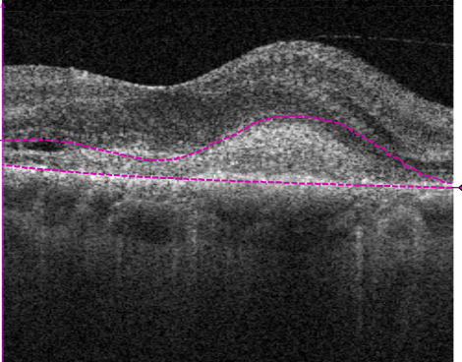
Custom AngioPlex map
Overlaid onto FA.
This layer illustrates the
presence of CNV.
B-scan with dashed purple lines delineating the layer
selected to create the custom
AngioPlex map.
Color depth encoded AngioPlex image
Overlaid onto traditional FA

Slide 6
Custom AngioPlex map
Overlaid onto FA.
This layer illustrates the
presence of CNV.
B-scan with dashed purple lines delineating the layer
selected to create the custom
AngioPlex map.
Color depth encoded AngioPlex image
Overlaid onto traditional FA

